Slide 1

Planning Website
Lec 3 CS 4640 Programming Languages for Web Applications

Slide 2
Setting Up Your Website
Planning
Content creation
Web design
Web development
Testing
Launching the website
Promoting the website
Measuring how well the site is fulfilling its purpose

Slide 3
Planning Your Website
Realizing the purpose of your website
Understanding web users and usability
Creating a sitemap
Planning interaction
Choosing a web host
Registering domain names

Slide 4
How People Use Sites
A website is like a house with a thousand doors,
and visitors can enter anywhere
Home pages are like signs on the freeway,
With users zipping by at 70MPH
The homepage
So much to say, so little time
Clarity is crucial
Users only read 20 to 30 words
Only 23% of users scrolled down the home page
Users are not reading – they are deciding where to go next

Slide 5
How People Use Sites (2)
Users are goal directed
Help them reach their goals
Four goals for a home page
Define the site (use your tagline)
Articulate what benefits are offered
Describe the company and its products
Provide navigation to the rest of the site
Interior page behavior
Users read more content on interior pages
Put important links in content area
Users spend 27 seconds looking at a page .. Do not make them think about the navigation

Slide 6
Search Dominance
88% of tasks started in a search engine
Search engines are replacing bookmarks
1994: Searches were used to find resources
2017: Searches are used to answer questions
Search Engine Results Page (SERP)
93% of users visit first SERP only
Only 47% scroll the first SERP (4 or 5 results from Google)
51% click on first site; only 16% click on second site

Slide 7
Scrolling
Users do not scroll
They are lazy and ignorant
Or … maybe they are busy
23% of users scroll the home page on the first visit
52% scroll interior pages
47% scroll SERPs
Users with more web experience scrolled more
Don’t make me think! [Steve Krug]
Don’t make me scroll!

Slide 8
Creating a Sitemap
Organize the content into meaningful sections -- match users’ mental model
Consider how the sections are related to each other
Use simple language to define each section, no jargon
Sitemap helps people if they get lost or can’t find something on your site
Search engines can use it to discover all your site’s content
Sitemap provides an overview of the main paths users can take to get between the main content areas

Slide 9
Creating Website Content CS 4640 Programming Languages for Web Applications
[Steve Krug, “Don’t make me think”, Chapter 2-3]
[Sean McManus, “Web Design,” Chapter 3]

Slide 10
Creating Website Content
Essential content for every website
About us/me
Contact page
Content ideas for business sites
How to find us
Meet the team
Product and service descriptions and photos
Customer service information
Content ideas for any website
Blog
What’s new
Tutorials
Games
Calculators and tools
Interviews

Slide 11
Things to Keep in Mind
If you publish an email address online, it will attract junk mail
Create content before designing website
Create content based on the site’s purpose
Consider using a mixture of different formats
All content is automatically protected by copyright

Slide 12
How Web Writing Differs
Users scan the page, not read
Good use of subheadings and lists is essential for getting your message across
Search engines will deliver people to the page that most closely matches their query, not necessarily your homepage
Sometimes people arrive at your site after following a link they’ve seen elsewhere
People can take any path through your content, following links to explore other sections at any time
Don’t assume that people are reading every word from page one

Slide 13
Top Web Writing Tips
Keep web pages reasonably short
Put readers first
Use a strong headline
Create a lively pace
Be consistent
Be specific
Avoid jargon
Make every word meaningful
Avoid passive voice

Slide 14
Images that Work
The number and size of pictures on a website is often the biggest factor in determining how long it takes to download
The best pictures are those that inform or entertain, and that help you to tell your story
Make sure your photos look good
Pictures are protected by copyright

Slide 15
Adding Map to Your Site
Open Google Maps (http://maps.google.com)
Search for your address. Make sure the map, Street View image, or directions you'd like to embed shows up on the map. Zoom and adjust the view so that you can see as much detail as you want
Click the Menu (top left corner)
Click Share or Embed map.
At the top of the box that appears, choose Embed map
Choose the size you want (small, medium, large, custom size), then copy the HTML embed code and paste it into the source code of your website

Slide 16
Top Mistakes in Web Design (2016)
Unexpected locations for content
Islands of information
Repetitive links
Hidden fees and prices
Poor search results
Overwhelming users with information
Hidden links

Slide 17
Top Mistakes in Web Design (2017)
Failing to use responsive design
Relying on a free website builder
Forgetting about actual design elements
Poor use of headers, sidebars, and footers
Not capturing customer information
Lacking top-quality content throughout
Making core information hard to find
Not keeping a website updated
Not dealing with broken and poorly optimized pages
Not paying attention to analytics

Slide 18
Top Mistakes in Web Design (2018)
Failing to use responsive design
Relying on a free website builder
Not providing necessary information/option: contact, search box, email
Music and videos that play automatically
Having a “Click here to enter” page
Overly use Flash components and client-side scripts
Designing cluttered pages with no whitespace
Ignoring standard practice
Poor menu and navigation design
Not understanding basic SEO

Slide 19
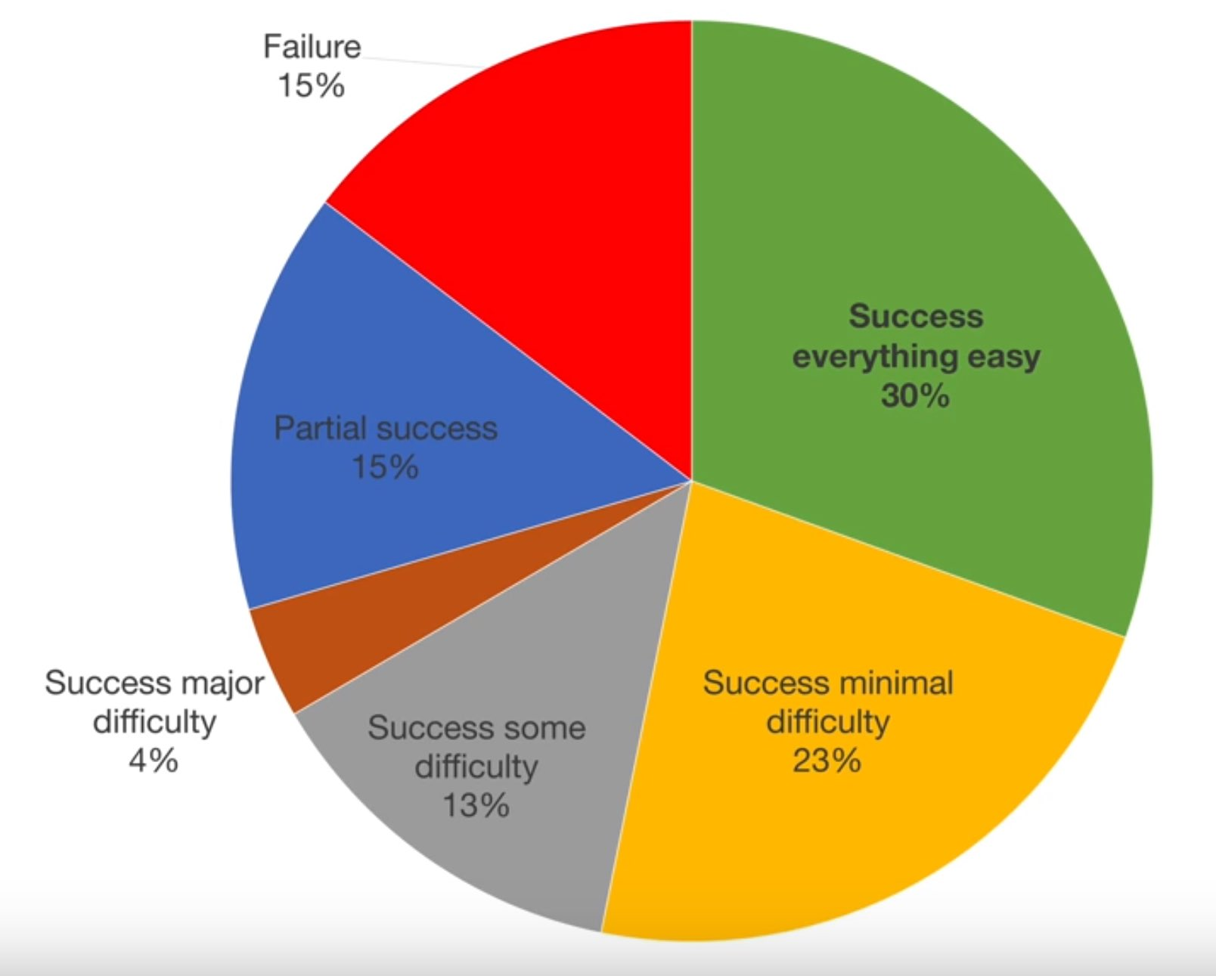
Degree of Task Success
The true goal
[Nielsen Norman Group, 2016]

Slide 20
Fonts
Five common problems
Text is too small
Text appears fuzzy
Text cannot be resized
Not enough contrast or too much contrast
Design elements overshadow text
These happen when designers get “cute” or “cool”
They focus on “look”, not “functioning”
Some badly designed sites are beautiful !

Slide 21
Top Guidelines For Fonts
Use common fonts
At least 10 point size
Avoid busy backgrounds
Use dark (black) text on light (white) backgrounds
Not light on dark
Keep distractions to a minimum:
Moving
All-caps
Graphical text

Slide 22
Make the UI Disappear
Less interaction, not more – what do users need?
Indicate status visually – pictures, not words
Don’t use dialogs to report normal behavior
Provide default behavior and ways to change it
Don’t ask questions, give users choices

